Slide 1
CS3907/CS6444: Big Data and Analytics Summer 2021 Stephen H. Kaisler, D.Sc.
Lecture 7:
Conceptual Modeling,
Graph Databases
&
Natural Language Processing

Slide 2
Conceptual Graphs
A conceptual graph (CG) is a logical formalism for structuring knowledge based on the existential graphs of Charles Sanders Peirce and the semantic networks of artificial intelligence.
Express meaning in a form that is logically precise, humanly readable, and computationally tractable.
John Sowa, IBM, created the Conceptual Graph notation in 1984.
Sowa, John F. 1984. Conceptual Structures: Information Processing in Mind and Machine. Reading, MA: Addison-Wesley
John F. Sowa, Knowledge Representation : Logical, Philosophical, and Computational Foundations, is not limited to conceptual graphs, but provides broad coverage of the entire field.
See http://conceptualstructures.org/
For the past 30 years, an annual conference has presented research: International Conferences on Conceptual Structures.
Notes:
A conceptual graph (CG) is a data structure for representing knowledge.
It correlates well with graph representations and, from early AI days, semantic networks.
CG’s are a powerful mechanism for representing detailed knowledge which can then be used to build graph data bases (GDB).
CGs can be created from parsing natural language sentences in a systematic way.
They can also be represented in logic form and, thus, amenable to reasoning algorithms.

Slide 3
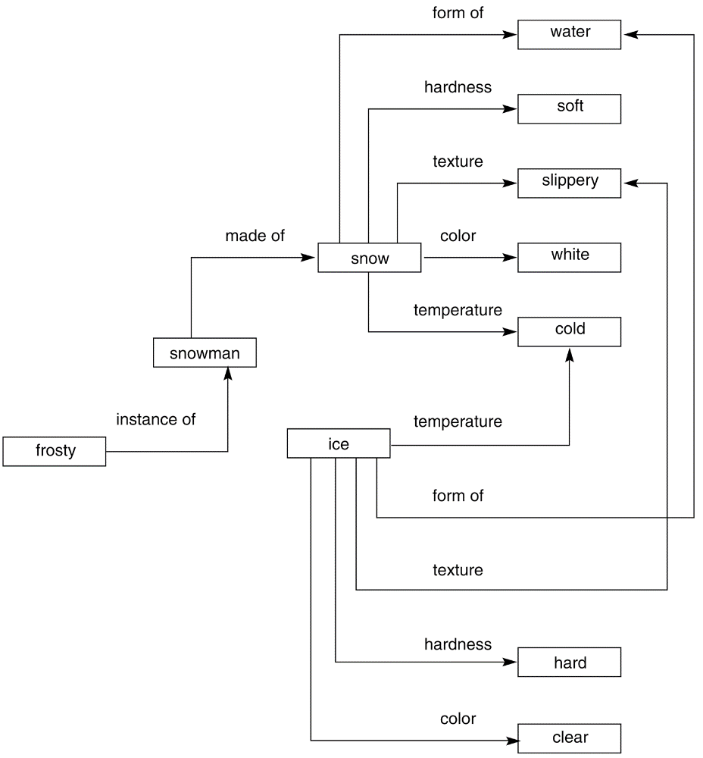
Semantic Networks
Marvin Minsky, one of the founders of AI, developed the concept of semantic networks.
A semantic network is an irregular graph that has concepts in vertices and relations on arcs.
Relations can be ad-hoc, but they can also be quite general, for example, “is a” (ISA), “a kind of” (AKO), “an instance of”, “part of”.
Relations often express physical properties of objects (color, length, and lots of others).
Most often, relations link two concepts.
Network representation of properties of snow and ice
Notes:
A sentence is centered on a verb that expects certain arguments.
For example, verbs usually denote actions (with agents) or states (with passive experiencers, for example, “he dreams” or “he is sick”).
By processing valid natural language sentences, we can extract the information to build semantic networks/conceptual graphs, and thus build and update data bases.

Slide 4
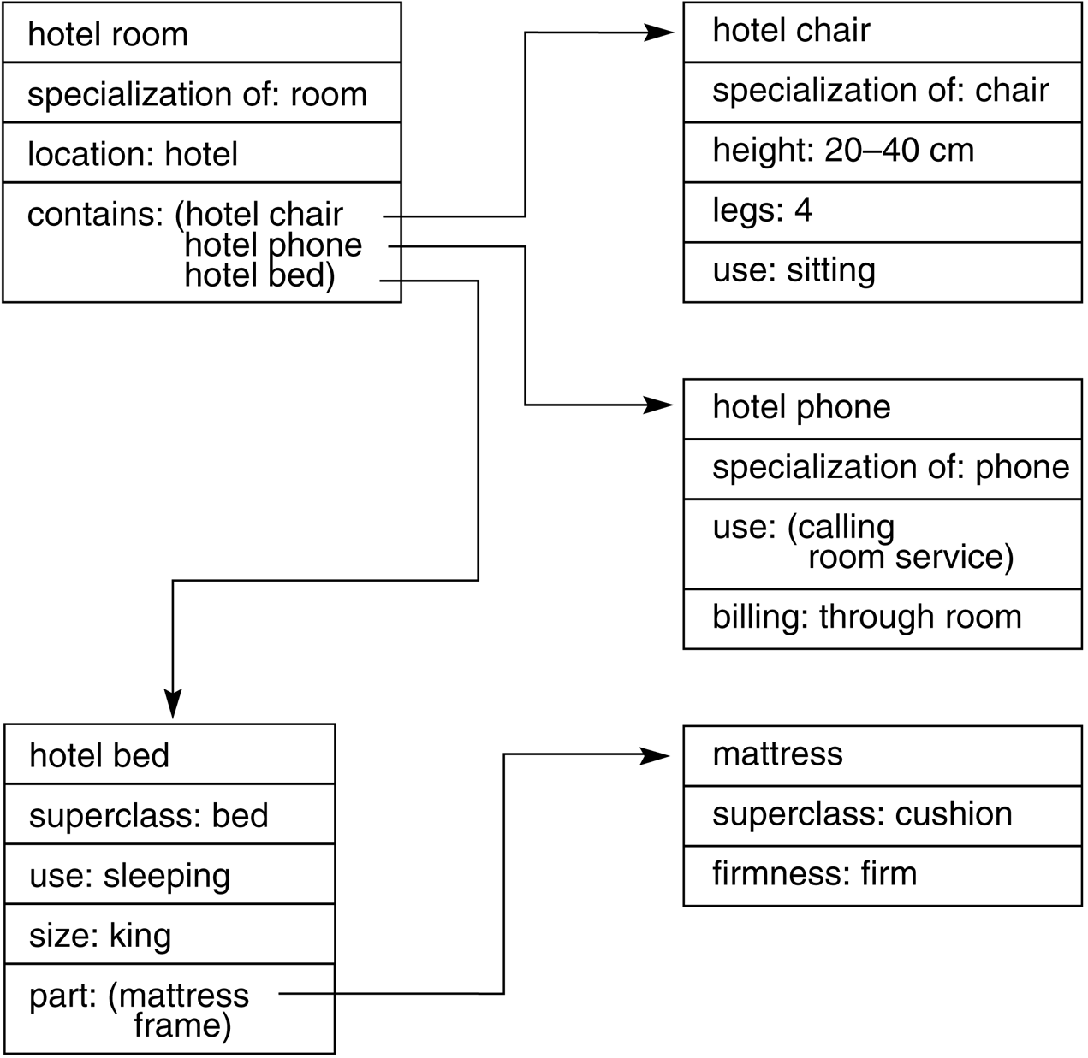
Frames
A frame represents a concept;
a frame system represents an organization of knowledge about a set of related concepts.
A frame has slots that denote properties of objects. Some slots have default fillers, some are empty (may be filled when more becomes known about an object).
Frames are linked by relations of specialization/generalization and by many ad-hoc relations.
Notes:
Frames originated with early AI research by Marvin Minsky at MIT.
Frames were an early form of object-oriented design and representation. You can see how they also relate to graph representations and tabular representations such as relational DBMSes.
Frames were used as the basis for many AI systems because of their flexibility and ability to accommodate different data types.

Slide 5
Conceptual Graph Elements
CG includes classes, relations, individuals and quantifiers.
Its semantics come from First Order Predicate Logic (FOPL).
CG Structure
Finite, connected, bipartite
Arcs are not labeled
Conceptual relation nodes are introduced between concepts
The bipartite nature of the graph means concepts can only link to conceptual relations and vice versa
In drawings, concepts are shown in boxes and conceptual relations in ellipses

Slide 6
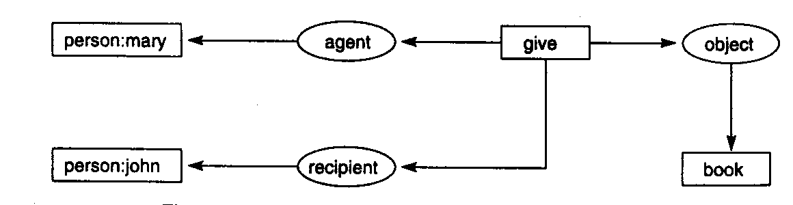
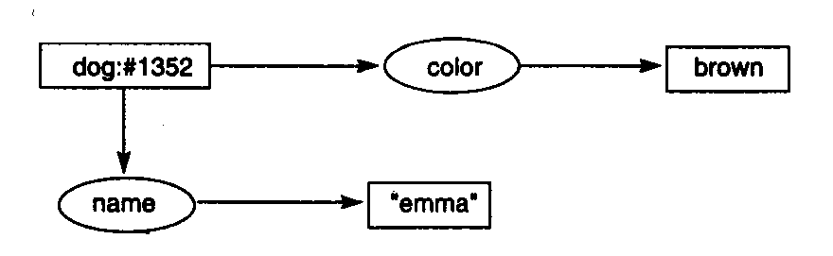
Conceptual Graph Structure
“Mary gave John the book”
Types: A brown dog is named emma.
“color” is an attribute of a dog
“give” is an or relation between two or more entities
Notes:
Unlike graphs, the arcs are not labeled. Rather connectors are represented by elliptical structures.
Knowledge objects are represented in rectangles.
Both objects and connectors can have attributes attached to them.
A good CG system will have predefined objects, connectors and attributes based on domain knowledge.
For specific domains, frameworks can be defined that are then populated with specific instances of objects, connectors, and attributes, e.g. assigned particular values.
A dog name emma is brown
Some dog is brown
These concepts can be combined to create the CG in the slide above.
Dog is a type (or class); “emma” is a specific individual.

Slide 7
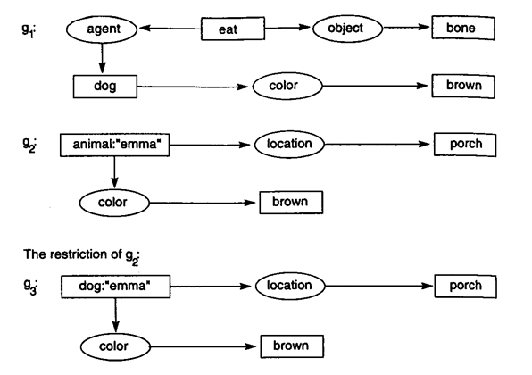
Generalization and Specialization
A concept node can be replaced with a restriction
A type label on a concept
may be replaced by one of
its subtypes as long as it
Is consistent with its
referent subtype.
Replace animal with dog
Because ‘emma’ is a dog.
Notes:
Here “agent” is a role in a statement: “Some agent eats bones”.
Specifically, “The brown dog eats bones”.
The second statement is: “emma – a brown animal – is on the porch”.
As we shall see in a moment, the set of objects can be formed into a hierarchy where a dog is an animal. This allows subordinate objects to inherit properties and attributes of superior objects.
Remember: Abstraction is an important principle in system design. It gives flexibility in constructing system, subsystem, and component designs.

Slide 8
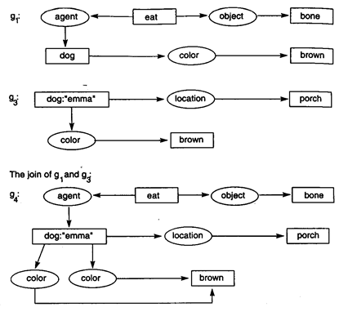
Joining Graphs (Concepts)
If two graphs contain an identical node, they can be joined together by having only one copy of the identical node
Join is a form of restriction since the resultant graph is more specific than the original graphs
Notes:
Note: Ontologies representing domain knowledge concepts can be represented as conceptual graphs.
“isa” is a relation that establishes a hierarch, with “animal” as a superclass of dog.
Other relations likes this are “ako” – “a kind of” & “part of” – is “a part of” another structure.
See the Reference Documents on Blackboard: cg-hbook.pdf and cg4cs.pdf

Slide 9
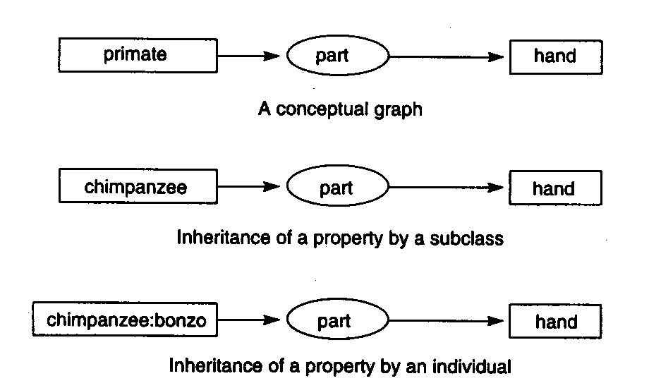
Inheritance
Inheritance is a form of generalization and specialization.
Generalization/Specialization does not guarantee that the resultant graph is true even if the original graphs are true.
Notes:
Inheritance – both generalization and specialization – are similar to those used in object-oriented systems.
So, we would have: chimpanzee ------ isa ------------ primate.
Therefore, a chimpanzee has a hand because primate has a hand.
And Bonzo has a hand because it is an instance of chimpanzee.
1951 Film: “Bedtime for Bonzo” starring Ronald Reagan.

Slide 10
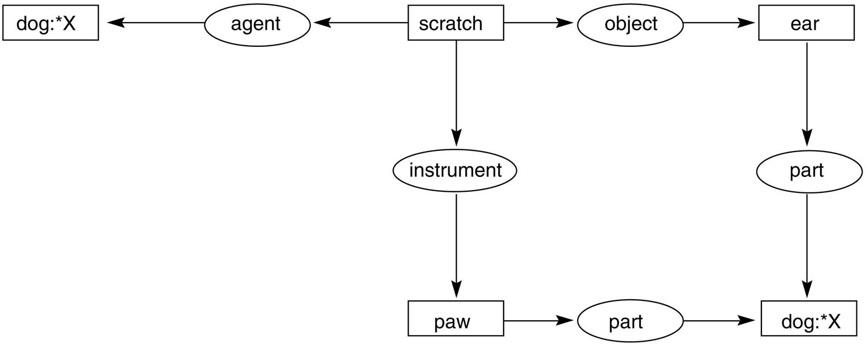
Variables give Flexibility
Some dog X can scratch or scratches its ear with its paw.
Note: When we consider merging two graphs which have the same concepts, but different variables, then we must perform resolution.
Resolution is a logic programming mechanism.
Notes:
We can represent arbitrary sentences using variables.
Some dog scratches an ear with a paw.
Note: We can easily translate English sentences to CGS.
There are methods for validating CGs to ensure consistency, etc.
Notice that we have to declare “ear” and “paw” as parts of a dog.
Resolution is a process of assigning equivalence between two (or more) variables if they are of the same data type.
This is covered in a course in logic programming. But, you can read about it on Wikipedia.
https://en.wikipedia.org/wiki/Resolution_(logic)

Slide 11
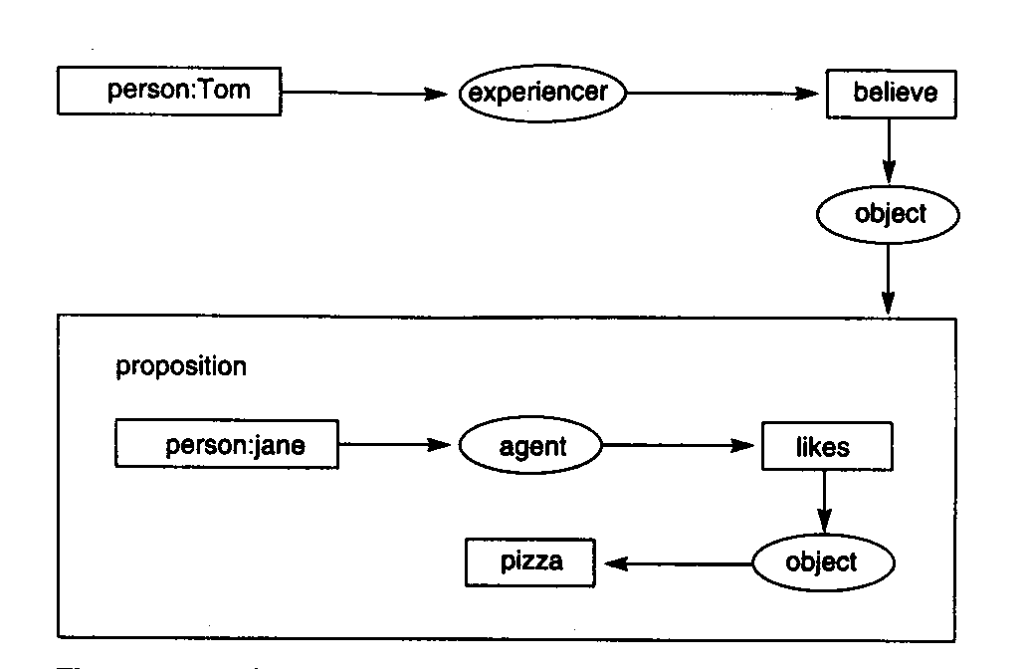
Propositional Nodes
“Tom believes that Jane likes pizza”
The verb “believes” takes a propositional node as its object
Notes:
Note that connectors are of different types.
“believe” is a modal connector, e.g., represents the possibility of a particular concept, which is represented here by a subordinate CG (in the box).
When we talk about Conceptual Dependency Theory in a few slides, you will see that there are several types of “transitions” or “connectors” specified.
A good MS Thesis topic would be to compile a preliminary dictionary of different types of “connectors” and their types.
Other modal connectors include should, would, could with appropriate infinitives, such as “He would go to the movies if he had money”.

Slide 12
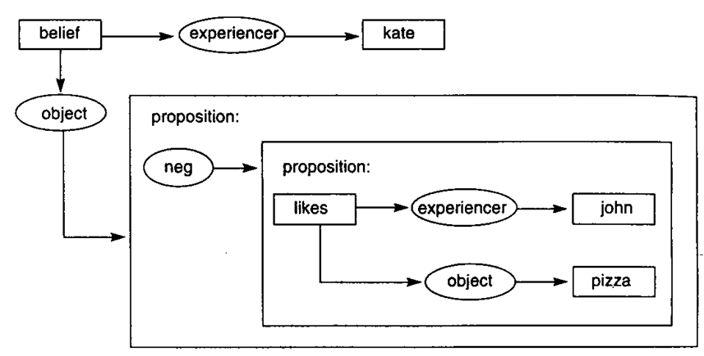
Complex Concepts
“Kate believes that John does not like pizza”
Notes:
We can build more complex CGs representing more complex statements out of simpler CGs.
Note the different way of expressing “believing:” by kate. We could have expressed kate’s ”believing” as in the previous slide.
Semantically, these are equivalent representations, just using different constructs.

Slide 13
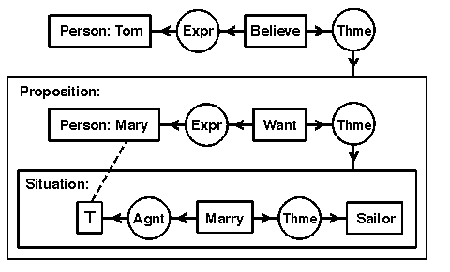
A Complex Conceptual Graph
Tom believes that Mary wants to marry a sailor
The concept of type Proposition is a context that describes a proposition that Tom believes
The proposition box contains another conceptual graph, which says that Mary is the experiencer of [Want], which has as theme a situation that Mary hopes will come to pass.
The dotted line, called a coreference link, shows that the concept [T] in the situation box refers to the same individual as the concept [Person: Mary] in the proposition box
Notes:
A context is a concept with a nested conceptual graph that describes the referent.
Inside that context is another context of type Situation, which describes a situation that Tom believes Mary wants. (Thme) to a proposition that Tom believes. The proposition box contains another conceptual graph, which says that Mary is the experiencer of [Want], which has as theme a situation that Mary hopes will come to pass. That situation is described by another nested graph, which says that Mary (represented by the concept [T]) marries a sailor. The dotted line, called a coreference link, shows that the concept [T] in the situation box refers to the same individual as the concept [Person: Mary] in the proposition box. Here is the Knowledge Interchange Format (KIF) statement:
(exists ((?x1 person) (?x2 believe)) (and (expr ?x2 ?x1) (thme ?x2 (exists ((?x3 person) (?x4 want) (?x8 situation)) (and (name ?x3 'Mary) (expr ?x4 ?x3) (thme ?x4 ?x8) (dscr ?x8 (exists ((?x5 marry) (?x6 sailor)) (and (Agnt ?x5 ?x3) (Thme ?x5 ?x6))
))
))
)))

Slide 14
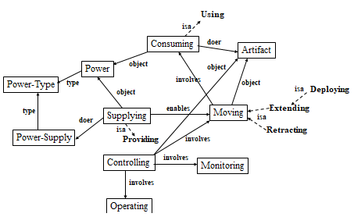
A Conceptual Graph for Many Sentences
Notes:
An interesting Conceptual Graph:
Exercise for students: How many sentences can you derive from this CG?

Slide 15
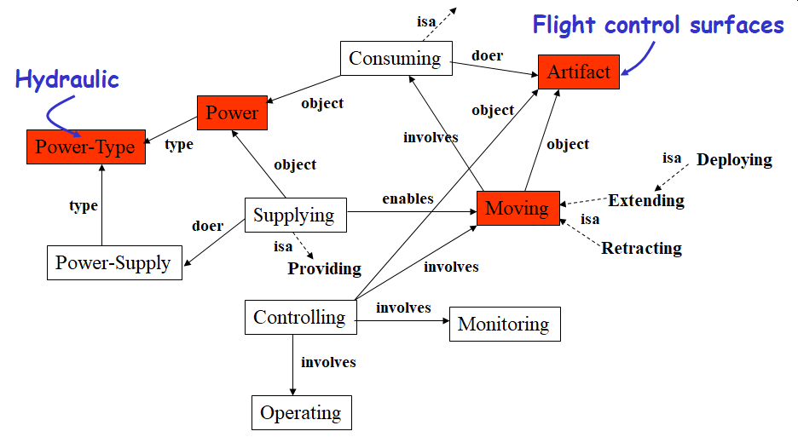
“Hydraulic power moves the flight control surfaces”
Notes:
A few sentences to get you started on the Student Exercise.

Slide 16
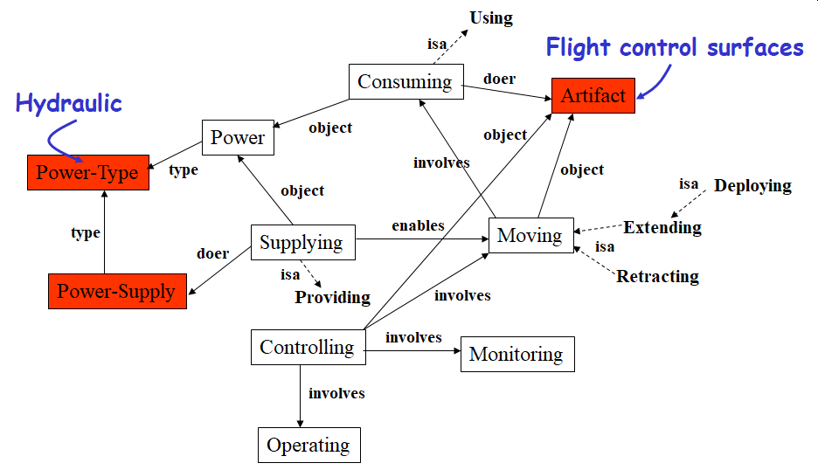
“The power supply for the flight control surfaces is hydraulic”

Slide 17
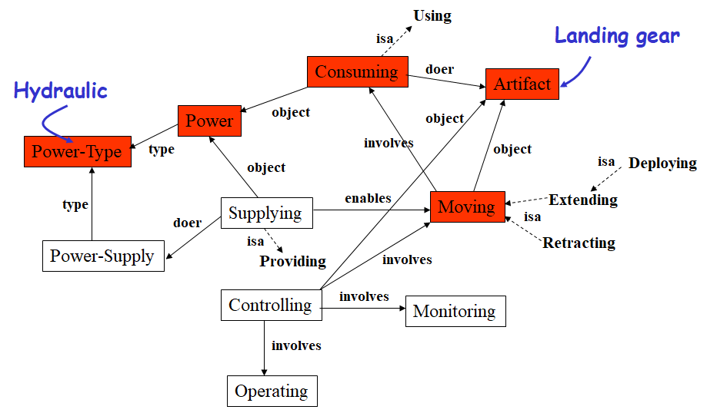
“Hydraulic power is used to extend and retract the landing gear”
But also, “The landing gear uses hydraulic power to deploy”
Notes:
The key concept here is:
CGs of sufficient complexity can represent many types of sentences in a compact form that allows you to visualize the information they represent.

Slide 18
Graph Databases
A Graph Database (GDB) is one of the four types of NoSQL databases we discussed in Lecture 6.
It is substantially different from the other three models although it is similar in some respects.
A GDB is:
optimized for the connections between records
really, really fast at querying across records
a database: transactional with the usual operations
“A relational database may tell you how many books you sold last quarter, but a graph database will tell your customer which book they should buy next.”
Notes:
You have experienced graph analytics using R and, perhaps, if you used str(…) or inspect(…) on some of the data structures, seen the underlying representation.
A graph DB can be thought of as a key-value store with support for relationships.
Relationships connect two nodes and both nodes and relationships can hold an arbitrary amount of key-value pairs.

Slide 19
Graph Databases
Graph databases allow you to store entities and relationships between these entities.
Entities are also known as nodes, which have properties.
Relations are known as edges that can have properties.
Edges have directional significance; nodes are organized by relationships which allow you to find interesting patterns between the nodes.
The graph model represents data as triples of the form <subject, predicate, object> tuple.
Complex relationships can be represented in this format, including network and mesh data structures
Multiple named edges between named nodes
Ex: find the books in the Databases category that are written by
someone whom a friend of mine likes.
Very useful for interconnected data, such as RDF databases
See the Linked Data book in Reference Books on Blackboard
Notes:
We noted that Graph Databases were on of the four models of NoSQL databases. There are many vendors, but the primary one seems to be Neo4j. Others are: GraphBase, AllegroGraph, AgensGraph (w/ Postgres SQL), GraphDB
Networks are graph with multiple possible edge of different types to connect two nodes.
Networks may be partially or completely connected as with graphs. Usually we lay out a network as a two dimensional structure in a plane.
Meshes allow n-dimensional connected networks. Both networks and meshes may have substructures. For example they may have subnetworks that are repeated multiple times and which are interconnected. Think of integrated circuits and memory chips and how they are laid out in layers.

Slide 20
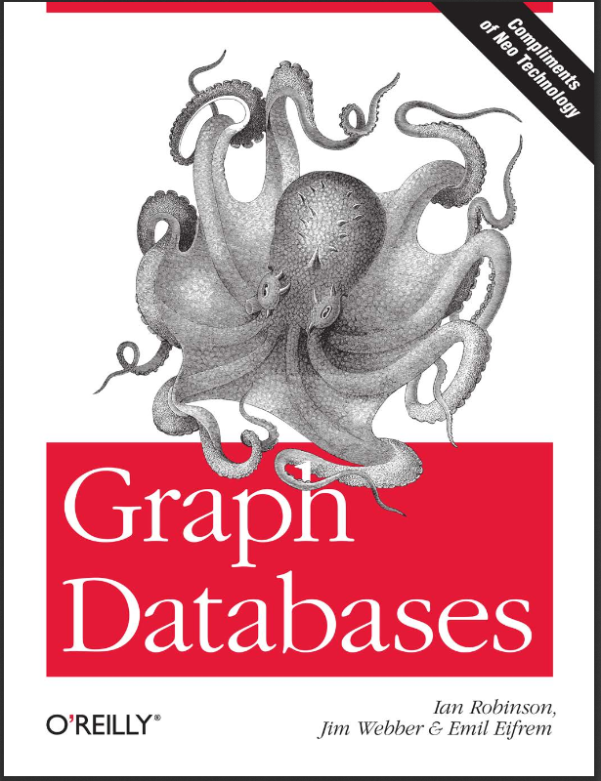
Graph Databases: On Blackboard
Notes:
This book is in the Reference Books section on Blackboard.
The authors are two of the designers and developers of Neo4J.
It is a good starting point for learning about Graph DBs.
You should look at the book Linked Data in Reference Books which discuses RDF databases which can be implemented in Neo4J.
We do not have time to discuss Resource Description Framework (RDF), but it is another formal representation mechanism.
Note that the size of XML and RDF databases is usually 3x to 5x the size of other DBs because of the symbolic representation of the statements.
A good MS Thesis or Doctoral Dissertation would develop a mechanism for compact representation for RDF statements that would significantly decrease the size of the DB.

Slide 21
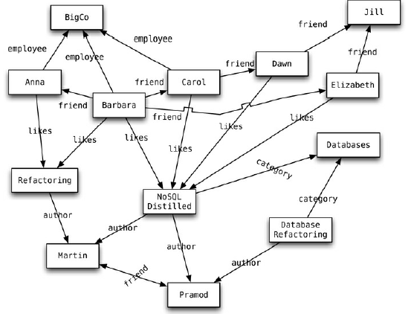
Graph: Example
Adapted From: NoSQL Distilled: A Brief Guide to the Emerging World of Polyglot Persistence, 2012
Notes:
A simple graph .
For example, Anna likes Refactoring which was authored by Martin who is also the author of NoSQL Distilled.
Each of these nodes would have attributes associated with them.
So, “Refactoring” would be of type “Book”
Dawn, Jill, and Elizabeth are all Persons with Gender female. Dawn and Elizabeth are friends of Jill.
As you can see, there are many paths that you can traverse to answer queries in this simple graph.
You have already seen that the number of paths explodes as you add more nodes when you worked on Project #1.
You also saw (I hope) that there may be many geodesics and many shortest paths between frontier nodes.
In transportation, in social networks, complex programs with complex call graphs, there will be many paths that you have to consider as you solve problems.

Slide 22
Graph Database
A GDB implements a model known as a property graph:
Nodes (“vertices”)
Nodes contain properties. Think of nodes as documents that store properties in the form of arbitrary key-value pairs.
Relationships (“edges”)
Relationships connect and structure nodes.
Properties
Properties are values about the node or relationship.
Properties can be added to nodes and relationships.
Allows you to create additional semantics to relationships.
GDBs store information as arbitrarily interconnected nodes linked by named relations, rather than as tables and joins.
Schema-less and highly extensible, they are an excellent choice for modelling semi-structured data in complex domains.
Notes:
Note that we circle back to this idea of key-value pairs or, as originally defined in Lisp, property lists. A node may have any number of properties. Properties may be of any type, but good configuration management usually restricts it to one type. The value of a property may be a handle to another node or to a list of handles of nodes.
“A graph ---- records data in ---- nodes ---- which have ---- properties”

Slide 23
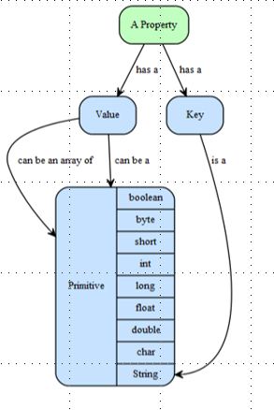
Graph Database: Properties
Properties are key-value pairs where the key is a string.
Property values can be either a primitive data type or an array of primitive data types.
NOTE: null is a not a valid data type; it is modeled by absence of a key.

Slide 24
Graph DBMS
A graph database management system (GDBMS) is a DBMS that supports CRUD* operations:
Normally optimized for OLTP = on line transaction processing
Supports general purpose graph data schema
An agile data modeling approach
No pre-defined schema
However, you need to define conventions for node types, edge types, and properties.
Graph Storage:
Graph native storage: optimized for storing and processing graphs
Graph Computing Engine:
A technology that is optimized to run global graph computational algorithms against large data sets
*CRUD = Create, Read, Update, Delete
Notes:
The four types of operations we can do on any data structure are: Create, Read, Update, Delete.
All other operations are just variants of these, albeit with parameters.
Graph DBs do not have a formal schema. Users can create it dynamically.
However, that does not facilitate governance or maintenance of the DB.
So, some formal structure is usually defined and extended under a configuration management process. This structure must not only define nodes and their attributes but possible linkages between types of nodes. And, there must be naming conventions that are followed in order to prevent chaotic growth that leads to confusing and conflicting information in the DB.
This almost mandates a Chief DB Designer who manages the governance of the DB. In a multiperson, complex project, this role is of essential importance. This person may also act as DB Administrator in the sense that s/he can allow others to create and reads, select persons to update nodes, but only and specific designated individuals can delete nodes.
All this is required to have a consistent database structure.

Slide 25
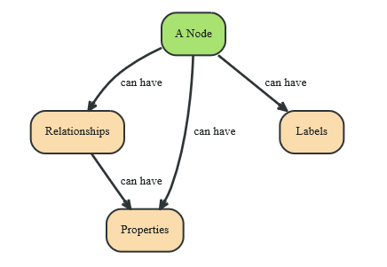
Designing a Graph DB - I
Identify the nodes and their relationships:
John and Sally are friends. Both John and Sally have read the book, Gone with the Wind.
Relationships:
John is a friend of Sally
Sally is a friend of John
John has read Gone with the Wind
Sally has read Gone with the Wind
Notes:
Most Graph DBs will be constructed from two sources:
Processing text, perhaps with NLP techniques, to extract relevant terms and their attributes.
From CSV/TSV files which have already been organized by other people.
In either case, the first thing to do is to identify what entities will become nodes in the graph. Entities can be either animate or non-animate.
We also need to identify what types of entities they are. So, John and Sally are Persons.
GWTW is a Book.
Usually, nodes are given a unique ID by a graph DBMS. Then, you define attributes for the nodes.
So, most nodes will have a Name attribute and a Type attribute.
So, Node 1 might be: Name: John, Type: Person

Slide 26
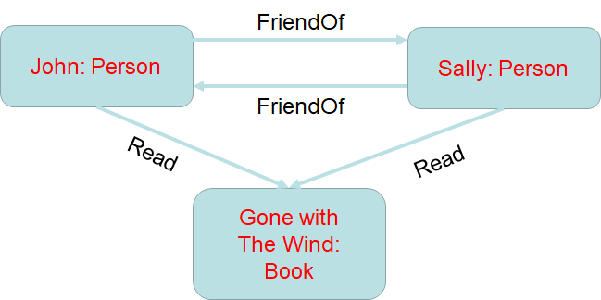
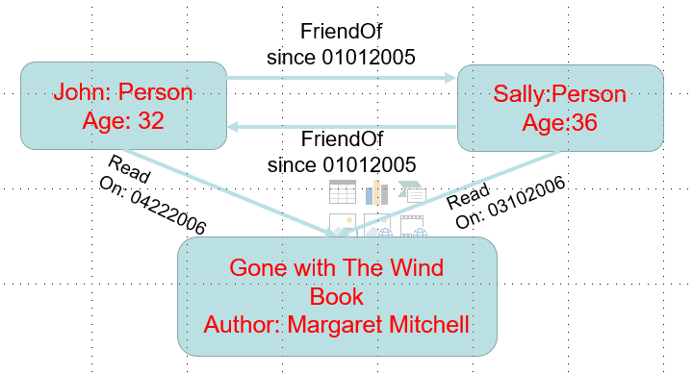
Designing a Graph DB - III
Extract the relationships
Relationships connect two nodes together
A node may have multiple relationships.
Traverse the graph by following a path through the graph based on one or more relationships.
Relationships may be unidirectional or bidirectional
Add attributes to enhance the graph
Notes:
Reviewing the statements in the previous slide, we see two types of relationships:
friendOf(John, Sally)
read(John, GWTW)
In our program, we might create a variable “John”.
Then when we create the node via the Graph DBMS, we would say John <- createNode(). The value assign to John is the Node handle.
Then we could create a relation “friendOf”. We need to tell the data type of the components in the relation.
So, we might say isFriendOf<-createRelation(“Name”, “friendOf”)
Then add the attributes:
-isFriendOf.addAttribute(“#arguments”, 2)
-isFriendOf.addAttributes(“Argument1”, Node, Type=”Person”)
-isFriendOf.addAttributes(“Argument2”, Node, TYPE=“Person”)
These are conceptual definitions not related to Neo4j or any other Graph DBMS.

Slide 27
Querying a Graph Database
Querying = Traversing the database
As McNeely puts it: “Walking on the Stepping Stones”
A query follows the relationships from node to node.
The results can be: A set; A path; A pattern
Key Idea: Every node has pointers/handles to its adjacent nodes based on relationships.
So, no index lookups are necessary (generally)
Write down a list of questions that can lead to additional data:
When did John and Sally become friends?
How old is John? Sally?
Who is the author of “Gone with the Wind”?
When was “Gone with the Wind” published?
… and more
The questions lead to attributes which can “decorate” nodes and edges
Notes:
Once we have created a database, we need to query it to retrieve information.
In Graph DBs, we start with a node and following its relations to gather information to solve our problem.
Knowing the structure of the DB and the data we have entered, we can begin to propose some queries that we might want to answer:
Note that questions above are interesting, but we will have to enter more data into the DB to answer them.
The point here is that – as you process the original data to be put it, with your knowledge of the domain, this should stimulate additional pieces of information that you would want to put in the DB and queries to retrieve that data.
Note that this will require finding other data sources to augment the original one.

Slide 28
Creating the Graph
CREATE (Sally: Person {name: “Sally”, age: 36})
CREATE (John: Person {name: “John”, age: 32})
CREATE (GWTW: Book
{ title: “Gone with the Wind”, author: “Margaret Mitchell” })
CREATE (Sally)-[:Friend_Of {since 01012005}]->(John)
CREATE (Sally)-[:Has_Read {on: 03102006}]->(GWTW)
CREATE (John)-[:Has_Read {on: 04222006}]->(GWTW)
Notes:
This shows how to perform certain operations in Neo4J using its Query language.
The query language is called Cypher Query Language (CQL), pronounced “cee quel”, probably with pun intended.
The structure is:
Sally is the node to which the relationship will be attached.
Has_Read is the relationship
on: <date> is an attribute of the relationship
GWTW is the destination node of the relationship.
Note that Sally could have many different Has_Read relationships to many different books.

Slide 29
Querying the Graph
When did John and Sally become friends?
MATCH (Sally: Person {name: ‘Sally’})
MATCH (John: Person {name: ‘John’})
MATCH (Sally)-[r: Friend_Of]-(John)
RETURN r.since AS friends_since
Who is the author of Gone with the Wind
MATCH (GWTW: Book {title: ‘Gone with the Wind’ })
RETURN GWTW: Author as author
Notes:
And, here are a few examples of how to query the DB using CQL.
In the first example, the three MATCH statements determine if there two nodes of type PERSON with the respective names Sally and John. The handles for these two nodes are stored in the variables “Sally” and “John”.
The third MATCH statement determines if there is a relationship between the two nodes of the type Friend_Of. If so, the handle is stored in “r”.
Finally, the RETURN statement returns the value of the attribute r.since.

Slide 30
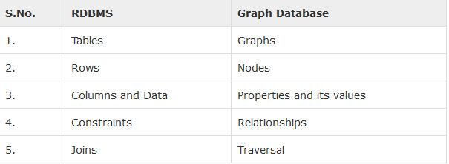
Neo4J
A graph database that was introduced in 2003
Very stable
Continuous updates
Full ACID Transactions
Dynamic Model Design
RDBMS Vs Graph Database
Current version: 4.0 (Open Source)
Notes:
I have used this Graph DB in two projects. It is a very powerful DB with a good API that can be called from Java.
The CQL query language is a little difficult to master.
Note that Neo4J supports both ACID transactions and its for-fee, distributed version also supports the BASE concepts (review Lecture 6).

Slide 31
Neo4j Data Access
No SQL!
Data access is programmatic
JVM languages have bindings to the same APIs
Java, JRuby, Jython, Clojure, Scala…
Core API
Deals with graphs in terms of fundamental characteristics:
Nodes & Properties
Key-Value Pairs
Relationships
Start node
End node
Properties
KV Pairs
Notes:
As we said in Lecture 6, Neo4j is a NoSQL DB.
The best way to get familiar with it is to read the Graph Databases book and try some of the examples.
Note, however, that this book was developed around the time of Neo4J version 1.0/2.0. So, there have been some significant improvements since then.
You should download the documentation from the Neo4j website if you download the DB.

Slide 32
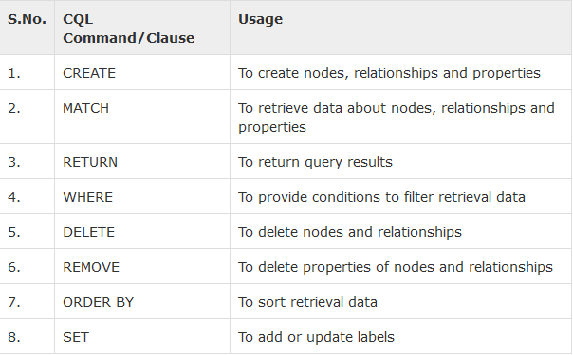
Cypher Query Language (CQL)
Probably no pun intended (or is it?)
A query language for Neo4j Graph Database.
It is a declarative pattern-matching language
It follows SQL-like syntax.
Notes:
CQL is a rich query language but it takes a while to master it because it is not as simple as SQL.
Look at the slides on Conceptual Graphs in Additional material. You will see that the way a Conceptual Graph is declared is similar to the way we use CQL.

Slide 33
Cypher Query Language
A SQL-inspired language: describe patterns in graphs visually using an ASCII-art syntax
Declarative: allows us to state what to select, insert, update or delete from the graph data without requiring us to describe exactly how to do it
Provides clauses for searching for patterns, writing, updating, and deleting data
Queries are built up using various clauses.
Clauses are chained together, and the they feed intermediate result sets between each other
Cypher query gets compiled to an execution plan that can run and produce the desired result
Statistical information about the database is kept up to date to optimize the execution plan
Indexes on Node or Relationships properties are supported to improve the performance of the application
Notes:
As noted, CQL is a declarative query language. So, you say what you want to retrieve from the DB.
Then, the Neo4J algorithms translate CQL statements into a set of procedures calls – a mini program – and execute that program using the API to retrieve the results for the query.
Neo4j keeps statistical information about queries that have been submitted so that it can try to optimize later queries. This is done internal to Neo4J.
Neo4J uses Lucene to create an index for Nodes and for Relationships. This is built internally and can significantly speed up querying.
Neo4j provides the user with the ability to create custom indices as well – again, using Lucene.

Slide 34
Neo4J Create Command
To create Nodes without properties
CREATE (emp:Employee)
emp is the node
Employee is the label
To create Nodes with Properties
CREATE ( <node-name>:<label-name>
{ <Property1-name>:<Property1-Value>
........
<Propertyn-name>:<Propertyn-Value> } )
To create Relationships between Nodes without Properties
To create Relationships between Nodes with Properties
To create single or multiple labels to a Node or a Relationship
Notes:
When you create a node, Neo4j returns a handle, which is not a “pointer”!
So, you should assign it to a variable or enter it into an ArrayList or other data structure.
The idea of a <label-name> is to associate a name with a category. A node may be a member of many categories.

Slide 35
Creating Relationships
transaction tx = db.beginTx();
try
{
Node theDoctor = db.createNode();
theDoctor.setProperty("character", "The Doctor");
Node susan = db.createNode();
susan.setProperty("firstname", "Susan");
susan.setProperty("lastname", "Campbell");
susan.createRelationshipTo(theDoctor, DynamicRelationshipType.withName("COMPANION_OF"));
tx.success();
}
finally
{
tx.finish();
}
Creating a node
Notes:
Here is how to enter data into a Neo4j DB.
Neo4j operates on a transaction basis. Go back and review the slides in lecture 6 where we talk about transactions.
You declare a transaction as show in the first line. This create a data structure which holds information about the transaction.
Note that is enclosed in try…catch structure.
I don’t show any exception handling here, but they would come before the “finally” clause.
You declare theDoctor as a Node and then you can set its properties (i.e., its attributes).
Creating a relationship is from a node to another node. You should give the relationship a name. There is an API call that let’s you list the relationships known within the DB, and for a node.
You close the transaction with a tx.success call, which allows Neo4j to commit all changes in the DB. (Remember what we meant by “commit”).
Failure to declare this cause the transaction to fail (as I found many time when I forgot to put it in.).

Slide 36
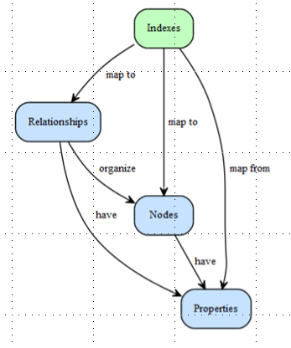
Neo4J
Keeps track of interesting nodes in your program
Use of indices trades read performance for write cost
Just like any database, even RDBMS
Just index key nodes
The ones that you want to navigate from within the database
“An index---maps from ---properties to--- nodes or relationships.
Notes:
Neo4J tracks the nodes and the relationships using Lucene indices.
Interesting nodes are ones that have been referenced many times via API calls or CQL queries. But, these span all of the nodes in the Graph DB.
You may create your own indices for subsets of nodes (and then use these indices in queries) by the CREATE INDEX command. So, you might create an index on nodes that have a specified value for an attribute.
Or. Nodes that have particular labels. You have a lot of flexibility in this regard.
Lucene is the default IndexManager
Supports many indexes per database
Each index supports nodes or relationships
Supports exact and regex-based matching
Supports scoring the number of hits in the index for a given item

Slide 37
Neo4J
Creating a node index:
Creating a relationship index:
Exact Matching:
GraphDatabaseService db = …
Index<Node> planets = db.index().forNodes("planets");
GraphDatabaseService db = …
Index<Relationship> enemies = db.index().forRelationships("enemies");
GraphDatabaseService db = …
Index<Node> actors = doctorWhoDatabase.index().forNodes("actors");
Node rogerDelgado = actors.get("actor", "Roger Delgado").getSingle();
Notes:
The first example shows how you can create a node index for just those nodes that have the label “planets”.
Similarly, the second shows you can create a relationship index for those relationships that have a label “enemies”
The last example uses a Doctor Who DB.
First, you create an index of actors from the DB.
Then using the index, you search for Roger Delgado and fetch the first node.

Slide 38
Neo4J
Query Matching:
Use Transactions to Modify Indexes:
GraphDatabaseService db = …
Index<Node> species = doctorWhoDatabase.index(.forNodes("species");
IndexHits<Node> speciesHits = species.query("species", "S*n");
GraphDatabaseService db = …
Transaction tx = db.beginTx();
try
{
Node nixon= db.createNode();
nixon("character", "Richard Nixon");
db.index().forNodes("characters“
.add( nixon, "character", nixon.getProperty("character"));
tx.success();
}
Catch … need some exception handlers here!
Notes:
In the first section, we use GraphDataBaseService to open a channel to the DB.
Then, create an index on Nodes for “species”
Then, query for a species type.
In the second section, we use a transaction to create node named “Nixon”
Then, we assign to “Nixon” an attribute “character” with the value “Richard Nixon”
Finally, we add to our index “characters” the “Nixon” node.
tx.success() only gets executed if the previous statements succeed.
It commits the results, thus leaving the DB in a consistent state.

Slide 39









Querying a Distributed Social Network
Mat,"HR"
Fred, "HR"
Ann, "CTO"
DC₁
Emmy,"HR"
Walt, "HR"
Ben,"MK"
DC₂
Ann, "CTO"
Dan,"DB"
Jack,"MK"
Mark,"FA"
Ross,"HR"
Mark, "FA"
Bill,"DB"
Q
Pat,"SE"
Tom,"AI"
DC₃
Ref: Fan, Wang, WU: Performance Guarantees for Distributed Reachability Queries
Notes:
Exercise for the Reader:
What is the path to get from Ann to Mark?
Are there more than one path?

Slide 40
Querying a Graph
Given a graph database and a query graph, find all the graphs containing this query graph
Problem: Scalability is a Big issue!
Naïve solution
Sequential scan (Disk I/O)
Subgraph isomorphism test (NP-complete)
Indexing mechanism is needed (Neo4j uses Lucene)
query graph
graph database
Ref: Graph Data Mining, by Jiawei Han & Micheline Kamber
Notes:
This is one of the major problems in Graph Analytics:
Can we find instances of subgraph within a larger graph?
This may be an exact match or a similarity match.
Scalability is the problem!
A brute force approach for exact match is:
Pick a node in a subgraph
Compare the subgraph to the graph by following the edges in the subgraph and matching them to edges in the graph.
When you try to do this for similarity matching, you have to find all nodes in the graph that have attributes equivalent to or similar to the nodes in the subgraph.
Which means you may have to search the whole graph.
This is what makes it NP-Complete.
NP-Complete: A decision problem whose answer can be computed by a brute force algorithm in polynomial time given the size of the input.
See: Garey, Michael R.; Johnson, D. S. (1979). Victor Klee (ed.). Computers and Intractability: A Guide to the Theory of NP-Completeness. A Series of Books in the Mathematical Sciences. San Francisco, Calif.:

Slide 41
Have an Indexing Strategy
Basic ideas:
Index substructures of a query graph to prune graphs that do not contain these substructures
Index substructures of the target graph
Query graph (Q)
Graph (G)
If graph G contains query graph Q, G should contain any substructure of Q
Substructure
Notes:
Here’s one solution.
Indexing is not guaranteed to find every instance of Query Graph Q, depending on how the matching is performed.

Slide 42
Neo4J Features
Dual License: open source and commercial (pay a lot!)
Well suited for cognitive modeling such as web applications.
Very flexible, BUT! Requires good governance.
Good performance over other types of databases for certain types of applications.
Neo4j claims very good scalability --- up to billions of nodes/relations/properties --- on a single machine.
[Note: I have not been able to verify this claim, but probably true only of the commercial license.]]
Can be sharded across multiple machines (only w/ commercial license).
Fully transactional – for reliability, accuracy and concurrency.
[Note: Supports ACID and BASE, mostly commercial]

Slide 43
Graphs & Networks: Challenges
Consider Facebook:
Over 2+ billion active users (as of 2017)
The graph of active users (as indicated by Friends) is both growing and changing topologically
Simple measures of growth fail to describe this graph
Some issues:
Real-life graphs are distributed across multiple nodes
Topology: interaction graph is low-diameter compared to total graph
Irregular Communities: size varies based on interest, geography, etc.
Overlap: members belong to many different communities
Allegiance: members join and leave communities at varying rates
Community structure: varies from community to community, so many possible templates
In short, traditional graph theory does not handle dynamically changing graphs very well.
Notes:
There are lots of challenges in Graphs & Networks:
Consider a given popular individual with say 1000 friends. Computing the spreading waves from each of those friends and their friends and their friends…
Well, you get the picture – it could be a very large graph!!
This graph changes topologically as people “friend” and “unfriend” others.
Some people drop out of Facebook – it lost of lot of users due to the Cambridge Analytica scandal.
Facebook pages are spread over thousands of servers. So, there communications costs to access all of that data.
Most users only access a small subgraph of this larger graph.
For a given individual, if you consider different subgroups of an individual – what we call “communities”, the intersection of memberships in all these communities might be null, but in any pair is highly likely to be non-null.
Traditional graph theory does not handle dynamic evolution of these types of graphs, but this is a rich area of study given the emergence of social media.

Slide 44
Creating Relationships
transaction tx = db.beginTx();
try
{
Node theDoctor = db.createNode();
theDoctor.setProperty("character", "The Doctor");
Node susan = db.createNode();
susan.setProperty("firstname", "Susan");
susan.setProperty("lastname", "Campbell");
susan.createRelationshipTo(theDoctor, DynamicRelationshipType.withName("COMPANION_OF"));
tx.success();
}
finally
{
tx.finish();
}
Creating a node

Slide 45
Neo4J
Creating a node index:
Creating a relationship index:
Exact Matching:
GraphDatabaseService db = …
Index<Node> planets = db.index().forNodes("planets");
GraphDatabaseService db = …
Index<Relationship> enemies = db.index().forRelationships("enemies");
GraphDatabaseService db = …
Index<Node> actors = doctorWhoDatabase.index().forNodes("actors");
Node rogerDelgado = actors.get("actor", "Roger Delgado").getSingle();

Slide 46
Neo4J
Query Matching:
Use Transactions to Modify Indexes:
GraphDatabaseService db = …
Index<Node> species = doctorWhoDatabase.index(.forNodes("species");
IndexHits<Node> speciesHits = species.query("species", "S*n");
GraphDatabaseService db = …
Transaction tx = db.beginTx();
try
{
Node nixon= db.createNode();
nixon("character", "Richard Nixon");
db.index().forNodes("characters“
.add( nixon,
"character", nixon.getProperty("character"));
tx.success();
}
finally
{
tx.finish();
}

Slide 47
Cypher Query Language (CQL)
Probably no pun intended (or is it?)
A query language for Neo4j Graph Database.
It is a declarative pattern-matching language
It follows SQL-like syntax.

Slide 48
Cypher Query Language
A SQL-inspired language: describe patterns in graphs visually using an ASCII-art syntax
Declarative: allows us to state what to select, insert, update or delete from the graph data without requiring us to describe exactly how to do it
Provides clauses for searching for patterns, writing, updating, and deleting data
Queries are built up using various clauses.
Clauses are chained together, and the they feed intermediate result sets between each other
Cypher query gets compiled to an execution plan that can run and produce the desired result
Statistical information about the database is kept up to date to optimize the execution plan
Indexes on Node or Relationships properties are supported to improve the performance of the application

Slide 49
Graphs & Networks: Challenges
Consider Facebook:
Over 2+ billion active users (as of 2017)
The graph of active users (as indicated by Friends) is both growing and changing topologically
Simple measures of growth fail to describe this graph
Some issues:
Real-life graphs are distributed across multiple nodes
Topology: interaction graph is low-diameter compared to total graph
Irregular Communities: size varies based on interest, geography, etc.
Overlap: members belong to many different communities
Allegiance: members join and leave communities at varying rates
Community structure: varies from community to community, so many possible templates
In short, traditional graph theory does not handle dynamically changing graphs very well.

Slide 50
Graphs & Networks: Challenges - I
Problem: static algorithms over dynamic graphs do not perform very well; need new algorithms
Problem: sparse graphs can be recast as sparse matrices or sets of sparse linear equations
Just shift the computational burden
Does not work well when you have attributes associated with nodes and edges
Problem: Handling noisy or incomplete information in graphs
Suppose you have templates for a certain class of nodes
If some information is missing in a node instantiated from a template, will your graph algorithms fail
How to ensure your graph algorithms proceed gracefully

Slide 51
Graphs & Networks: Challenges - II
Problem: sampling a dynamic graph/network at fixed intervals – what can we learn?
Problem: multiple edges connecting nodes lead to multiple paths through the graph?
How does the number of paths increase?
Problem: merging or splitting graphs; what are the criteria?
(Equivalent to the Merge Problem in Ontologies)

Slide 52
References
Barabasi, Albert-Laszlo. 2002. Linked: The New Science of Networks. Cambridge: Perseus Publishing
Robinson, I., J. Webber, and E. Eifrem. 2015. Graph Databases, Neo Technologies, Inc., published by O’Reilly Media. Sebastopol, CA:
Scott, John. 2000. Social Network Analysis: A Handbook. London: Sage Publications.
Wasserman, Stanley, and Katherine Faust. 1994. Social Network Analysis: Cambridge University Press.
Neo4j Web site: https://neo4j.com/
Cypher Refcard https://neo4j.com/docs/cypher-refcard/current/
Webber, Jim. "A programmatic introduction to Neo4j." Proceedings of the 3rd annual conference on Systems, programming, and applications: software for humanity. ACM, 2012.
Bruggen, Rik. Learning Neo4j. Birmingham, UK: Packt Pub, 2014
Sowa, John F. (1984) Conceptual Structures: Information Processing in Mind and Machine, Addison-Wesley, Reading, MA
Sowa, John F. (2000) Knowledge Representation: Logical, Philosophical, and Computational Foundations, Brooks Cole Publishing Co., Pacific Grove, CA

Slide 53
Natural Language Processing
What is NLP?
NLP is the branch of computer science focused on developing systems that allow computers to communicate with people using everyday language.
Speech and Text:
Generation
Understanding (e.g., deriving meaning from)
by computer for some useful purpose.
“I’M SORRY DAVE, I’M AFRAID I CAN’T DO THAT”:
Hal, 2001, Stanley Kubrick film.
Two approaches:
Statistical Analysis: Latent Semantic Analysis, Latent Dirchlet Allocation, Neural Nets, etc.
Grammar-based: Rules drive the analysis of text and extraction of meaning
In either case:
Natural languages are messy and difficult to
parse with computers.

Slide 54
Syntax, Semantics, Pragmatics
Syntax concerns the proper ordering of words and its affect on meaning.
The dog bit the boy.
The boy bit the dog.
Semantics concerns the (literal) meaning of words, phrases, and sentences.
“plant” as a photosynthetic organism
“plant” as a manufacturing facility
“plant” as the act of sowing
Pragmatics concerns the overall communicative and social context and its effect on interpretation.
The ham sandwich wants another beer. (co-reference, anaphora)
John thinks vanilla. (ellipsis)
Ref: Ghufran Baig, CS288 Natural Language Processing

Slide 55
Problem: Ambiguity - I
Natural language is highly ambiguous and must be disambiguated.
Ex: I saw the man on the hill with a telescope.
Q: Did I use the telescope to see the man?
Q: Did the man on the hill have a telescope?
Which is the case? Cannot tell from the sentence alone!
Pragmatics:
From “The Pink Panther Strikes Again”:
Clouseau: Does your dog bite? Hotel Clerk: No. Clouseau: [bowing down to pet the dog] Nice doggie. [Dog barks and bites Clouseau in the hand] Clouseau: I thought you said your dog did not bite! Hotel Clerk: That is not my dog.
Ref: Ghufran Baig, CS288 Natural Language Processing

Slide 56
Problem: Ambiguity - II
Ambiguities can multiply the number of possible interpretations of a sentence, … a paragraph, … a document.
In English, a sentence ending in n prepositional phrases has over 2^{n} syntactic interpretations (cf. Catalan numbers).
“I saw the man with the telescope”: 2 parses
“I saw the man on the hill with the telescope.”: 5 parses
“I saw the man on the hill in Texas with the telescope”: 14 parses
“I saw the man on the hill in Texas with the telescope at noon.”: 42 parses
“I saw the man on the hill in Texas with the telescope at noon on Monday” 132 parses
Ref: Ghufran Baig, CS288 Natural Language Processing

Slide 57
Problem: Ambiguity - III
Many jokes depend on ambiguity:
Groucho Marx: One morning I shot an elephant in my pajamas. How he got into my pajamas, I’ll never know.
Noah took all of the animals on the ark in pairs. Except the worms, they came in apples.
Policeman to little boy: “We are looking for a thief with a bicycle.” Little boy: “Wouldn’t you be better using your eyes.”
Why is the teacher wearing sun-glasses. Because the class is so bright.
So, Processing natural language text involves many various syntactic, semantic and pragmatic tasks in addition to other problems.
Ref: Ghufran Baig, CS288 Natural Language Processing

Slide 58
Syntactic Analysis - I
Identify and utilize syntactic structure:
“grouping words” , forming phrases
noun phrases: sam schwartz, executive vice president; approximately 5 kg, more than 30 peasants
verb groups: retired, will be succeeded
finding grammatical functional relations through parsing
subject, (direct/indirect) object, main verb
Beware of classic NLP problems
problems e.g. with prepositional phrases to the right of a noun
”I saw the man in the park with a telescope.”
the prepositional phrases can be associated both with ”man” and with ”saw”

Slide 59
Syntactic Analysis - II
Associated with each constituent are certain features which can be tested by patterns in subsequent stages
for verb groups: tense (past/present/future), voice (active/passive), baseform/stem
for noun phrases: baseform/stem, is this phrase a name?, number (singular/plural)
Attach semantic properties and constraints based on attributes
Must include domain-specific semantic properties and constraints
Use common patterns:
appositive construction: company-description, company-name
prepositional phrase construction: position of company
Link together constituents into semantic hierarchy, e.g., is-a hierarchy
Also, establish known ontological relationships

Slide 60
Syntactic Analysis - III
Scenario Matching and Analysis
Scenario patterns can help to focus attention on specific constituents, including directing search
For example: one pattern must precede another logically
person retires as position
person is succeeded by person
Used in several terrorist scenarios
killing of <HumanTarget>
<GovOfficial> accused <PerpOrg>
bomb was placed by <Perp> on <PhysicalTarget>
<Perp> attacked <HumanTarget>’s <PhysicalTarget> with <Device>
<HumanTarget> was injured
Build an ontology of patterns that can be used to reconstruct the meaning of the document
For example: a change of status report
Resolve anaphoric references by pronouns and definite noun phrases
Criteria: recency of use, number agreement, etc.
Ontological support

Slide 61
Syntactic Tasks - IV
Word tokenization:
Breaking a string of characters into a sequence of words.
These methods are called “tokenizers”
In Java, String.split, StringTokenizer
But, in ideographic languages (Kanji, Hangul,…), words are not separated by spaces.
In English, punctuation can also separate words
Morphological analysis:
A morpheme is the smallest linguistic unit with semantics
Ex: “carried” ➔ carry + ed.
But: unlockable ➔ un + (lock + able) ?, or
unlockable ➔ (un + lock) + able ?
Called stemming, but the literature shows that stemming does not generally improve performance for morphologically rich languages, e.g., English
Ref: Ghufran Baig, CS288 Natural Language Processing

Slide 62
Syntactic Tasks - V
Part Of Speech (POS) tagging:
Annotate each word in a sentence with a part-of-speech.
Ex: I ate the spaghetti with meatballs.
Pro V Det N Prep N
Ex: John saw the saw and decided to take it to the table.
PN V Det N Con V Part V Pro Prep Det N
Phrase Chunking:
Find all non-recursive noun phrases (NPs) and verb phrases (VPs) in a sentence.
Ex: [NP He ] [VP reckons ] [NP the current account deficit ] [VP will narrow ] [PP to ] [NP only # 1.8 billion ] [PP in ] [NP September ]
Original Brown Univ. Corpus:
Had 87 tags, but some redundancy and conflict
Use Penn Treebank set of POS Tags:
45 tags, comprehensive
Ref: Ghufran Baig, CS288 Natural Language Processing

Slide 63
Syntactic Tasks - Va
Treebank Tags:
Noun (person, place or thing)
Singular (NN): dog, fork
Plural (NNS): dogs, forks
Proper (NNP, NNPS): John, Springfield
Personal pronoun (PRP): I, you, he, she, it
Wh-pronoun (WP): who, what, where, when, why
Verb (actions and processes)
Base, infinitive (VB): eat
Past tense (VBD): ate
Gerund (VBG): eating
Past participle (VBN): eaten
Non 3rd person singular present tense (VBP): eat
3rd person singular present tense: (VBZ): eats
Modal (MD): should, can
To (TO): to (to eat)

Slide 64
Syntactic Tasks - Vb
Adjective (modify nouns)
Basic (JJ): red, tall
Comparative (JJR): redder, taller
Superlative (JJS): reddest, tallest
Adverb (modify verbs)
Basic (RB): quickly
Comparative (RBR): quicker
Superlative (RBS): quickest
Preposition (IN): on, in, by, to, with
Determiner:
Basic (DT) a, an, the
WH-determiner (WDT): which, that
Coordinating Conjunction (CC): and, but, or,
Particle (RP): off (took off), up (put up)

Slide 65
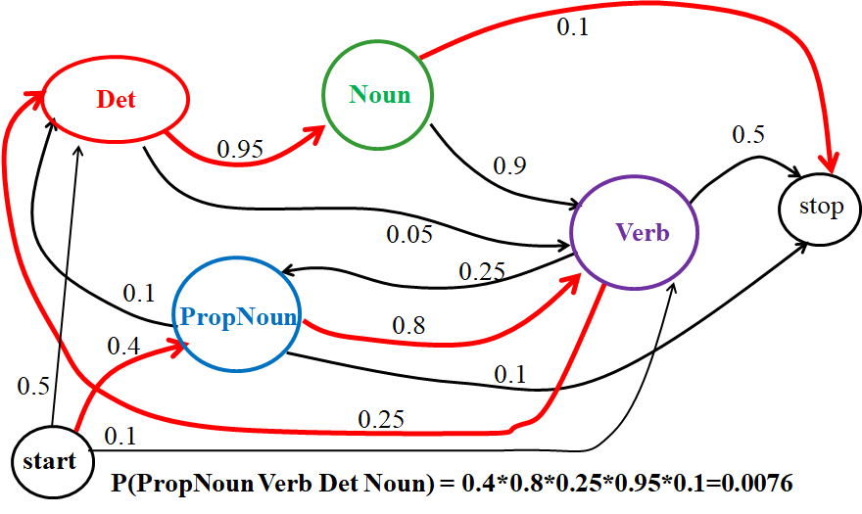
Syntactic Tasks - Vc
Statistical Approach:
Markov Model: finite state machine w/ probabilistic state transitions
Assumes next state depends only on current state – no history
Source: R. J. Moooney,
UTexas-Austin,
POS-Tagging.ppt

Slide 66
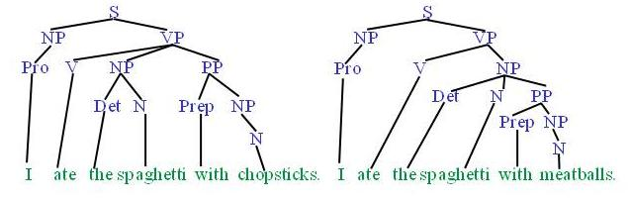
Syntactic Tasks - VI
Syntactic Parsing:
Produce the correct syntactic parse tree for a sentence.
Ref: Ghufran Baig, CS288 Natural Language Processing

Slide 67
Semantic Tasks - I
Word Sense Disambiguation:
Words usually have a fair number of different possible meanings.
Often dependent on the POS
Ellen has a strong interest in computational linguistics.
Ellen pays a large amount of interest on her credit card.
Can use WordNet 3.0 from Princeton University
Semantic Role Labeling:
For each clause, determine the semantic role for each noun phrase that is an argument to a verb.
agent patient source destination instrument
John drove Mary from Austin to Dallas in his Toyota Prius.
Bioinformatics:
AGCTAACGTTCGATACGGATTACAGCCT
Ref: Ghufran Baig, CS288 Natural Language Processing

Slide 68
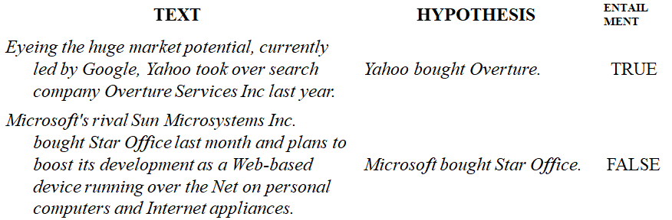
Semantic Tasks - II
A semantic parser maps a natural-language sentence to a complete, detailed semantic representation.
Ex: Mapping an English sentence to a Prolog form.
How many cities are there in the US?
answer(A, count(B, (city(B), loc(B, C),
const(C, countryid(USA))),
A))
Textual Entailment: determining if one sentence implies another (e.g., context establishment)
Ref: Ghufran Baig, CS288 Natural Language Processing

Slide 69

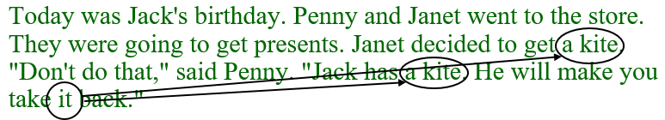
Pragmatics - I
Anaphora Resolution/Co-Reference: determining which phrases in a document refer to the same entity:
This can require substantial reasoning (usually via rules):
Ellipsis Resolution: Omitted words/phrases can be inferred from sentence context.
"Wise men talk because they have something to say;
fools, because they have to say something.“ (Plato)
Ref: Ghufran Baig, CS288 Natural Language Processing

Slide 70
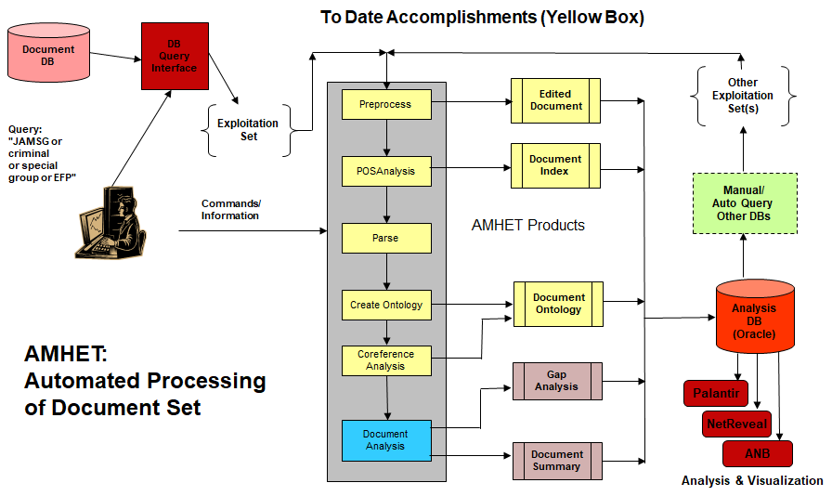
Automated Mining of HUMINT and Electronic Text
Source: SH Kaisler research

Slide 71
Text Categorization - I
Distinguish between:
Assigning documents to classes
Assigning subjects to documents
Categories are just symbolic labels
No metainformation conveyed
All decisions must be based on document content
No external knowledge used
Assume:
methods do not depend on any application-dependent knowledge
In real life, all kinds of knowledge can be used
content-based decisions are necessarily subjective
it is often difficult to measure the effectiveness of the classifiers
even human classifiers do not always agree

Slide 72
Text Categorization - II
Single-label Categorization
Exactly 1 category must be assigned to each d_{j} ∈ D
Special case: each d_{j} must be assigned either to category c_{i} or to its complement ¬ c_{i}
Multi-label Categorization
Any number of categories may be assigned to the same d_{j} ∈ D
Author Attribution:
Given the known writings of a small number of authors A₁,…,A_{n} , determine which of them wrote document X.
Early research focused on classical works: Bible, Shakespeare, etc.
The most famous work is Mosteller & Wallace (1964) on the Federalist Papers
The proliferation of online text offers many new research opportunities

Slide 73
Information Extraction - I
Information extraction systems analyze unrestricted text in order to extract information specific to a particular domain.
Do not attempt to understand all of the text
Identify phrases referring to specific entities
Relevancy of information determined by pre-defined domain guidelines
Must specify accurately the types of information the system is looking for
Consider it a task of filling in a template to describe a document
Problem: it retains virtually all the information that is relevant to the domain without any discrimination between important information and details and general information.
Given a corpus of relevant and irrelevant texts, use a case-based approach to select texts from an unprocessed set
Examine correlation between new text and existing cases
Degree of correlation is selection criterion
Update cases if new text has high degree of correlation and new information

Slide 74
Information Extraction - II
Information extraction involves the creation of a structured representation (such as a database) of selected information drawn from the text
Example
19 March - A bomb went off this morning near a power tower in San Salvador leaving a large part of the city without energy, but no casualties have been reported.
According to unofficial sources, the bomb - allegedly detonated by urban guerrilla commandos - blew up a power tower in the northwestern part of San Salvador at 0650 (1250 GMT)
Extracted Information:
Incident type bombing
Date March 19
Location El Salvador: San Salvador (city)
Perpetrator urban guerilla commandos
Physical target power tower
Human target -
Effect on physical target destroyed
Effect on human target no injury or death
Instrument bomb

Slide 75
Information Extraction - III
Six Stages of Processing:
Local text Analysis
Lexical Analysis
Name Recognition
Full Syntactic Analysis
Identify Facts Using Task-Specific Patterns
Integration
Coreference Analysis
Inference New Facts
Example:
Tom Turner retired as executive vice president of the famous hot dog manufacturer, Hot Dogs Are Us. He will be succeeded by Harry Himmelfarb.
Q: Who is president of Hot Dogs Are Us?

Slide 76
Information Extraction - IV
Once entities are recognized, identify specific relations between entities
Employed-by
Located-at
Part-of
Example:
Michael Dell is the CEO of Dell Computer Corporation
and lives in Austin Texas.
Also, need to identify modifier relationships using adjectives, adverbs, and prepositional phrases which provide additional information about nouns and verbs.
And, need to handle clauses – both prefix and postfix, which also provide additional information.
Clauses are usually complete sentences, but the connecting POS specifies what noun they connect to.
Source: R. J. Mooney,
UTexas-Austin,
InformationExtraction.ppt

Slide 77
Entity Ambiguity
Sources:
From a name presented in different forms:
IBM, IBM Corp., IBM Corporation, International Business Machines Corporation, …
From the existence of several entities with the same name:
George (H.W.) Bush and George W. Bush
From spelling mistakes in a name
From honorifics or titles that lead to gender mislabeling or title mislabeling, etc.
7/11/2021
7/11/2021
77
77

Slide 78
Why Disambiguate?
Human language is not exact.
Text referring to the city "Roanoke" can mean "Roanoke, Virginia" or "Roanoke, Texas", depending on the surrounding context.
Organizations and companies often have multiple nicknames, name variations, or common misspellings.
Famous persons ("Michael Jackson") often share a name with many non-famous individuals.
A difficult problem due to the numerous NL conventions that humans generally use and understand.
7/11/2021
7/11/2021
78
78

Slide 79
Entity Disambiguation
Entity disambiguation is the problem of determining whether two mentions of entities refer to the same object:
e.g., trying to decide whether the entity called "Jim Clark" in one document is the same as the entity called "Jim Clark" in another document.
Given a set of terms (single words, phrases), resolve these terms in to the least possible set of terms:
Resolve the terms such that terms that refer to the same entity are collected into a single subset
A similar definition applies for relation and event disambiguation
7/11/2021
7/11/2021
79
79

Slide 80
People’s Names (and Titles)
Some names denote multiple entities:
“John Williams and the Boston Pops conducted a summer Star Wars concert at Tanglewood.”
John Williams ⇒ John Williams (composer)
“John Williams lost a Taipei death match against his brother, Axl Rotten.”
John Williams ⇒ John Williams (wrestler)
“John Williams won a Victoria Cross for his actions at the battle of Rorke’s Drift.
John Williams ⇒ John Williams (soldier)
Issue: Some entities are more complex than others, e.g., noun phrases as opposed to people’s names
7/11/2021
7/11/2021
80
80

Slide 81
Question Answering - I
Question classification
Use predefined question classes: when, who, where, whom, why, description
Allow ad hoc questions?
Answer type
What kind of answer are we looking for?
What format should the answer be presented in?
Keyword extraction
Which keywords should be given to the search engine?
What, which, how, and name are less clear
What time is the plain arriving?
What city is the plane arriving at?
What is the name of the pilot of the plane?

Slide 82
Question Answering - II
The question focus may be found from keywords in the question
a phrase in the question that disambiguates it and emphasizes the type of answer being expected
time -> when; city -> where; pilot -> who; plane -> what
Question word and question focus can be used to decide the type of the answer
when, where, why are straightforward:
when -> time
where -> place
why -> reason

Slide 83
Question Answering - III
Who, whom
Often the answer is a person’s name
Who is the president of Finland?
Can be a description
Who is Steve Jobs?
pattern: (who|whom) (is|are|was) ProperNoun
Can be a group of people
Who beat the Bears in the Super Bowl? (Indianapolis Colts)
How
how old -> age
how much -> quantity
how long -> distance
default: how -> manner

Slide 84
Machine Translation
Automatic translation of a text in one language into another language. Still very difficult.
Google has made some significant gains in this area.
Good translation requires ambiguity resolution
An apocryphal story is that an early MT system gave the following results when translating from English to Russian and then back to English:
“The spirit is willing but the flesh is weak.” ⇒
“The liquor is good but the meat is spoiled.”
“Out of sight, out of mind.” ⇒ “Invisible idiot.”
So, context is very important.
Need domain knowledge to do good translation.

Slide 85
References
Miner, G., D. Delen. J. Elder, et al. 2012. Practical Text Mining and Statistical Analysis for Non-Structured Text Data Applications, Elsevier
Silge, J. and D. Robinson. 2017. Text Mining with R, O’Reilly Media, Sebastopol, CA
Mosteller, F. and D. L. Wallace. Inference and Disputed Authorship: The Federalist. Reading, MA., 1964
Holmes, D. I. and R. S. Forsyth (1995). The Federalist Revisited: New Directions in Authorship Attribution. Literary and Linguistic Computing 10 (1995) 111–27.
Jurafsky and Martin, SPEECH and LANGUAGE PROCESSING: An Introduction to Natural Language Processing, Computational Linguistics, and Speech Recognition, Second Edition, McGraw Hill, 2008
Sebastiani, F. 2002. Machine Learning in Automated Text Categorization, ACM Computing Surveys, 34(1).

Slide 86
Additional Material

Slide 87
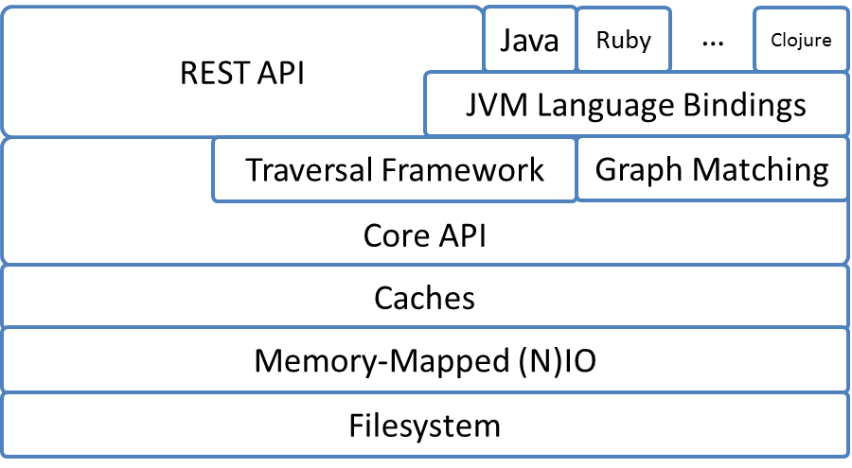
Neo4J System Architecture
Supports low-level
graph abstractions
Declaratively describe
how to look for data
in a graph
separate stores for nodes, relationships, properties,
and optimizations for common cases to ensure that
data is found in one file (e.g., short strings)
Neo4J is a Java database, so very flexible bindings
Notes:
Neo4j Is written in Java. When you create a Neo4J DB in a directory, you will find that it creates a number of files in that directory.
Do not put anything else in that directory!
Do not try to access those files independently as you may corrupt the database, whose contents and descriptors are spread over those files.
The REST API allows you to access Neo4j from a browser on another machine.
The Traversal Framework handles the execution of CQL queries after they translated into an execution plan.

Slide 88
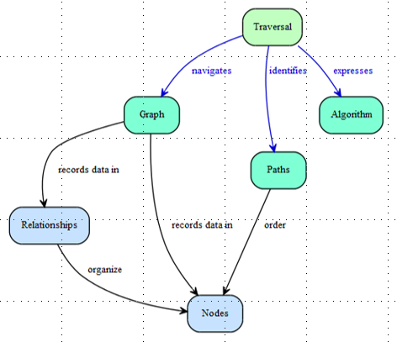
Graph Traversal
“A traversal --- navigates --- a graph by identifying --- paths -which order --- nodes”
Notes:
We query graphs by traversals.
Based on the query criteria, we search fro paths from a Starting Node to zero or more Ending Nodes that satisfy the query.
Consider questions such as:
“What music do my friends like that I don’t own”
Or
“If this power supply fails, what web services will be affected”

Slide 89
Neo4j APIs
REST API
Designed with discoverability in mind (discover URIs where possible)
Stateless interactions store no client context on the server between requests
Supports streaming results, with better performance and lower memory overhead
HTTP API
Transactional Cypher HTTP endpoint
POST to a HTTP URL to send queries, and to receive responses from Neo4j
Drivers
The preferred way to access a Neo4j server from an application
Use the Bolt protocol and have uniform design and use
Available in four languages: C# .NET, Java, JavaScript, Scala, and Python
Additional community drivers for: Spring, Ruby, PHP, R, Go, Erlang / Elixir, C/C++, Clojure, Perl, Haskell
API is defined independently of any programming language
Procedures
Allow Neo4j to be extended by writing custom code which can be invoked directly from Cypher
Written in Java and compiled into jar files
To call a stored procedure, use a Cypher CALL clause
Notes:
You can query from Neo4J from several different languages.
In previous work, I had a complex Java program for working a specific problem where I used the Java drivers to access the database because I needed to analyze the data returned in different ways.
It was much more efficient to load and unload data from the DB using Java API functions than to use the Query language.

